Slide 1
MOTAMARRI DHATRI
Final Project

Slide 2


AGENDA
Introduction
Problem Statement
Project Overview
Who are the end users?
Solution and its value proposition
The wow in your solution
Modelling
Results
3/21/2024 Annual Review

Slide 3


KEYLOGGER AND SECURITY
A keylogger is a computer program that records every keystroke made by a computer user, especially in order to gain fraudulent access to passwords and other confidential information.
It is a form of malware or hardware that keeps track of and records your keystrokes as you type. It takes the information and sends it to a hacker using a command-and-control (C&C) server.

Slide 4
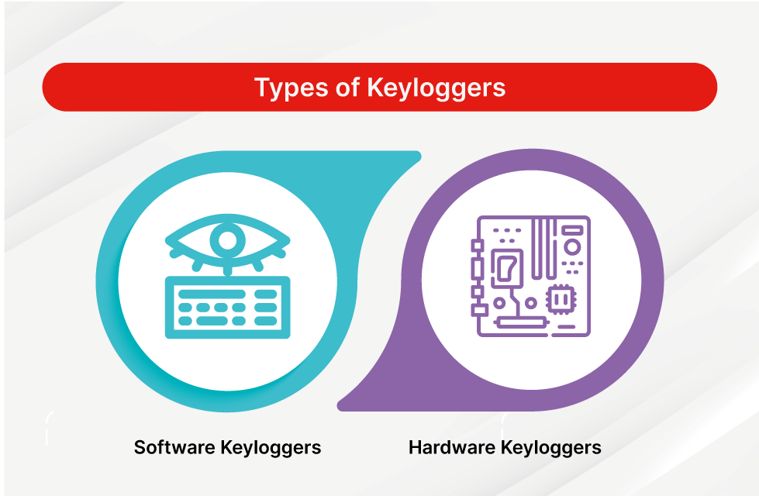
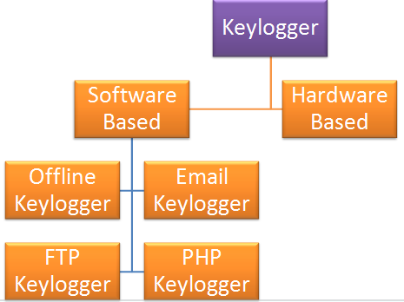
Types of Keyloggers
Hardware Keylogger
It is a device that is used for recording the keystrokes. It starts its applications when it is been plugged in. Now the information gets stored in the device. So to retrieve the data hackers/attackers have to physically access that.
The hardware keylogger is undetectable as it can appear as an external device that is attached to the computer. It is not detectable by the anti-virus, and it is hard to be detectable. It allows the attacker to get to know the confidential details and more details from the victim.
Software Keylogger
It is a program that is designed to record any input entered by the user from the keyboard. It is also used in organizations to troubleshoot some problems related to technology. This is something that is installed on the hard drive. This type of software is also called spy software.
Software keylogger sometimes detectable and can also be removed by anti-spyware. it is used to record typed passwords, or credit card numbers, and more. This software keylogger has some features which enable someone to do screen record and more.

Slide 5

PROBLEM STATEMENT
In the realm of cybersecurity, keyloggers pose a serious threat due to their ability to inconspicuously capture and record keystrokes.
These malicious programs can result to significant breaches of security by intercepting sensitive information such as passwords, financial data, private information and confidential communications.
This project aims to understand the intricacies of keyloggers by developing a functional keylogger using Python and tkinter for the graphical interface, and pynput for capturing keyboard events, aiming to explore and understand these malicious programs in depth.

Slide 6

PROJECT OVERVIEW
Objective:
The primary objective of this project is to develop a
keylogger using Python, tkinter for the graphical interface,
and pynput for capturing keyboard events and also understand
the functionalities and potential threats posed by keyloggers.
Scope:
Implementation: Build a keylogger that can capture and log
keystrokes, saving the data in both text and JSON formats.
Analysis: Explore the mechanics of keyloggers, how they
operate, and their consequences on cybersecurity.
Detection and Prevention: Explore and propose methods to
detect and prevent keylogger attacks.

Slide 7


WHO ARE THE END USERS?
Employers: Observe employees' computer activities to ensure productivity and
adherence to company policies (with legal and ethical considerations).
Parents: Supervise their children's internet usage to protect them from online dangers.
Device Owners: Track possible unauthorized activity on their devices to enhance
personal security.
Law Enforcement Agencies: Analyze incidents involving computer use to gather
evidence and understand criminal activities.
Keyloggers are used in IT organizations to troubleshoot technical problems with computers and business networks. Families and businesspeople use keyloggers legally to monitor network usage without their users' direct knowledge.

Slide 8

YOUR SOLUTION AND ITS VALUE PROPOSITION
How to Protect yourself from Keyloggers?
Use Security Software:
Install reputable antivirus and anti-malware software.
Consider outsourcing security to a managed detection and response provider.
Keep Software Updated:
Regularly update your OS, applications, and security software to patch vulnerabilities.
Use Common Sense:
Avoid downloading files or clicking on links from unknown sources.
Be cautious with email attachments from unfamiliar senders.
Use Virtual Keyboards:
Utilize virtual keyboards for security-sensitive activities like entering passwords.
Regular Security Scans:
Perform regular malware scans to identify and remove potential threats.
Don’t Forget Physical Security:
Be vigilant about physical security risks, especially in public places.
Check for suspicious devices attached to the computer or keyboard.

Slide 9
YOUR SOUTION AND ITS VALUE PROPOSITION
Solutions for Keylogger Threats
Keystroke Encryption Software
Value Proposition: This type of software encrypts keystrokes at the driver level before
they reach applications, making it extremely difficult for keyloggers to capture meaningful
data. By protecting the data from the moment it is typed, it adds a robust layer of security against
keylogging attacks.
Virtual Keyboards
Value Proposition: Virtual keyboards can be used for entering sensitive information.
Since virtual keyboards simulate keystrokes using mouse clicks, they bypass hardware and
software keyloggers that rely on traditional keyboard inputs.
Two-Factor Authentication (2FA)
Value Proposition: Implementing 2FA reduces the risk posed by keyloggers, as even if a keylogger
captures a password, the second factor (such as a mobile authentication code) is still needed to gain access.
This adds an additional security layer beyond just password protection.

Slide 10
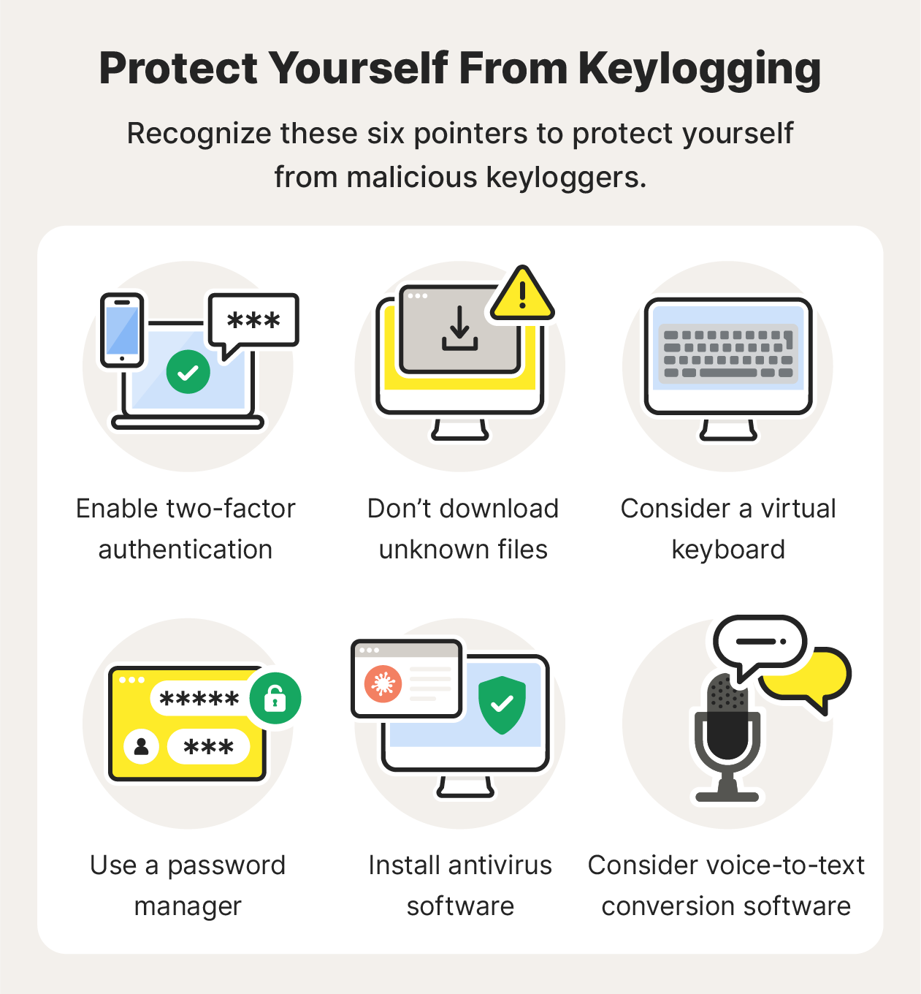

THE WOW IN YOUR SOLUTION
The wow factor is encapsulated in the robustness and comprehensiveness of the solution. By combining advanced detection techniques, innovative keystroke protection, user-centric measures, enhanced authentication protocols, and continuous user education and system updates, the solution provides a formidable defense against keyloggers. This multi-faceted approach not only protects sensitive information but also offers peace of mind to users and organizations, ensuring their data security in an increasingly digital world.
3/21/2024 Annual Review
10

Slide 11
MODELLING
Architectural Overview:
System Components:
Keylogger: Captures keystrokes.
Tkinter GUI: Provides a graphical interface for starting and stopping the keylogger.
Pynput Listener: Monitors and logs keystrokes.
Storage: Saves logs in text and JSON formats.
Data Flow:
Real-Time Data Handling:
Keystrokes are immediately processed and categorized.
Data is simultaneously logged into both text and JSON formats.
Storage and Retrieval:
Text logs provide a readable format for review.
JSON logs enable structured data analysis.
11

Slide 12
Workflow Explanation:
Initialization:
The Tkinter interface initializes and displays start/stop buttons.
Starting the Keylogger:
User clicks the "Start" button, invoking the start_keylogger() function.
The Pynput listener starts, capturing keystrokes.
Logging Keystrokes:
Keystrokes are captured and processed by on_press() and on_release() functions.
Logs are updated in real-time and saved to files.
Stopping the Keylogger:
User clicks the "Stop" button, invoking the stop_keylogger() function.
The Pynput listener stops, halting keystroke logging.
12

Slide 13
Key Functions:
on_press():
Function: Captures the key pressed event.
Details: Records and logs 'Pressed' and 'Held' keys.
Code Snippet:
def on_press(key):
global flag, keys_used, keys
if flag == False:
keys_used.append(
{'Pressed': f'{key}'}
)
flag = True if flag == True:
keys_used.append(
{'Held': f'{key}'}
)
generate_json_file(keys_used)
13

Slide 14
on_release():
Function: Captures the key release event.
Details: Records and logs 'Released' keys.
Code Snippet:
def on_release(key):
global flag, keys_used, keys
keys_used.append(
{'Released': f'{key}'}
)
if flag == True:
flag = False
generate_json_file(keys_used)
keys = keys + str(key)
generate_text_log(str(keys))
14

Slide 15
generate_text_log():
Function: Writes the logged keystrokes to a text file.
Details: Saves the cumulative keystrokes in key_log.txt.
Code Snippet:
def generate_text_log(key):
with open('key_log.txt', "w+") as keys:
keys.write(key)
generate_json_file():
Function: Writes the logged keystrokes to a JSON file.
Details: Saves the keystrokes in key_log.json in JSON format.
Code Snippet:
def generate_json_file(keys_used):
with open('key_log.json', '+wb') as key_log:
key_list_bytes = json.dumps(keys_used).encode()
key_log.write(key_list_bytes)
15

Slide 16
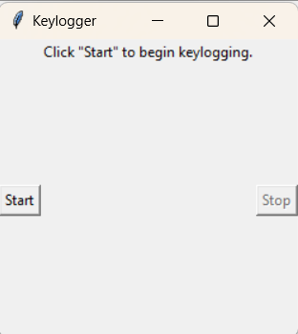
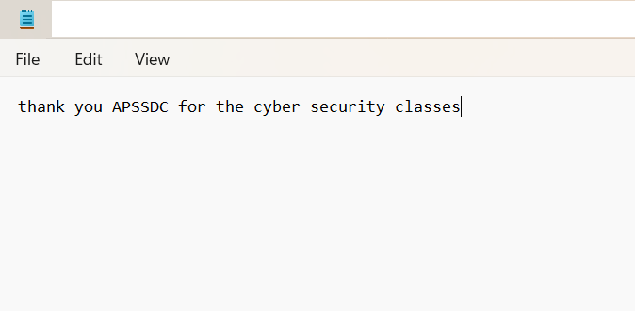
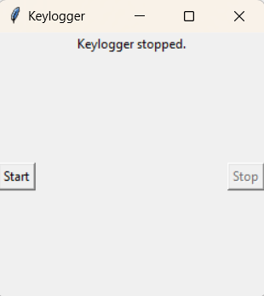
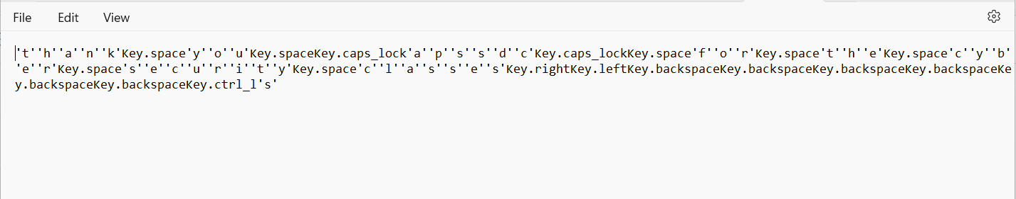
RESULTS
16

Slide 17
PROJECT LINK
https://github.com/DHATRI-MOTAMARRI/motamarri_dhatri.git
17

